Slide 1
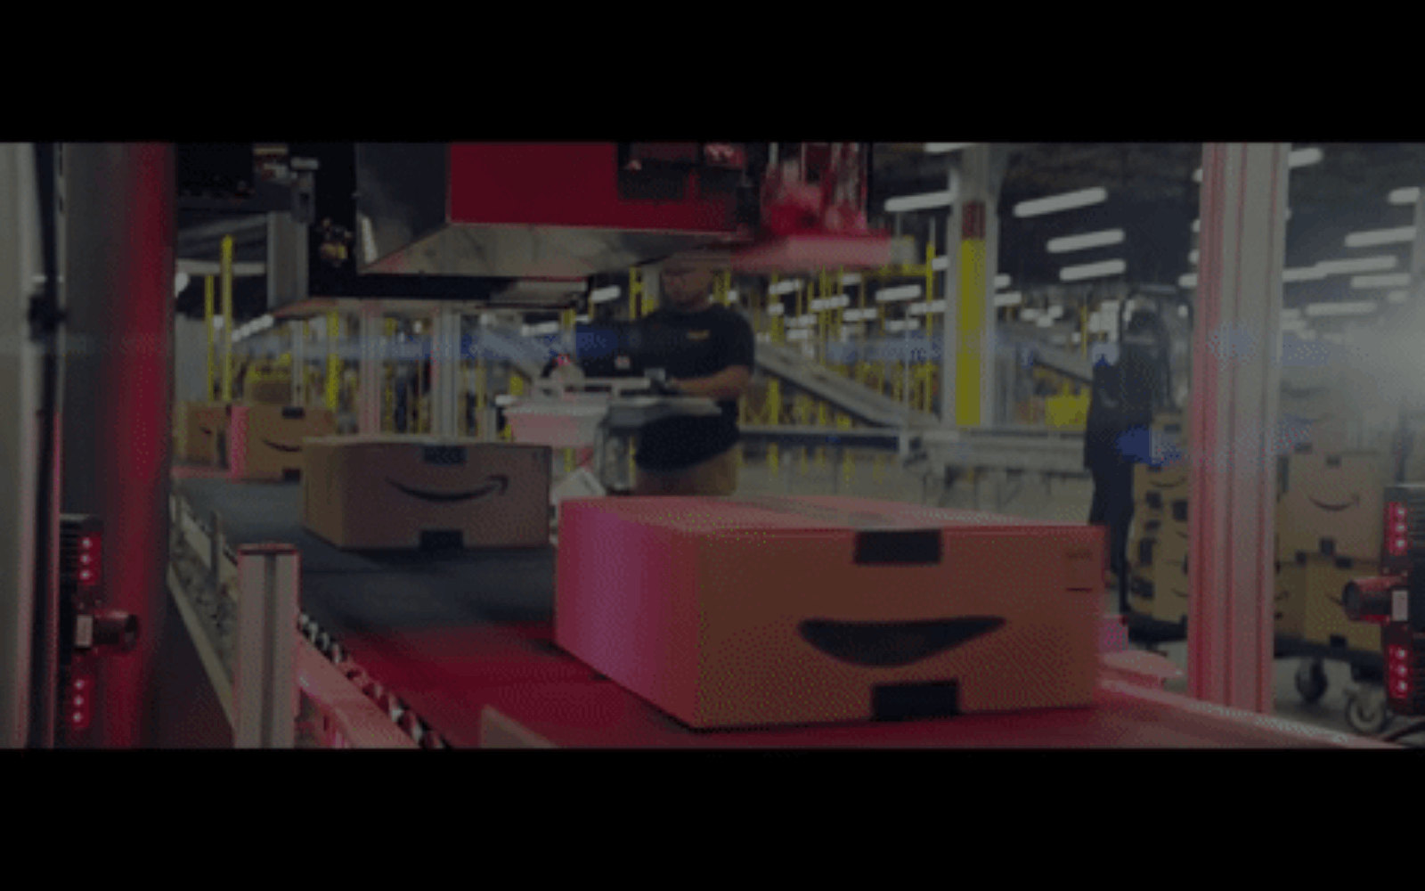


Predicting Yearly Amount Spent for Ecommerce
Mini Project 1
Len Kwok
For Shopee

Slide 2


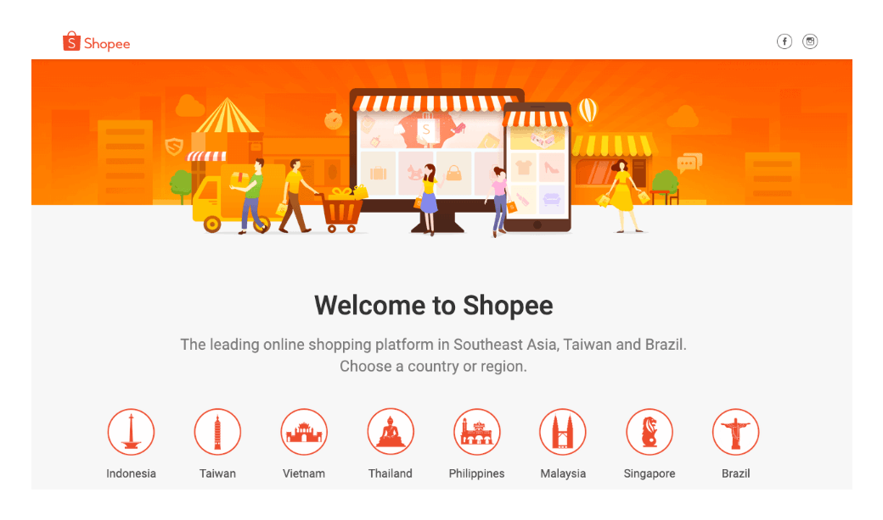
Shopee - Leader of ecommerce in SEA
Entering Australia 20/21?

Slide 3



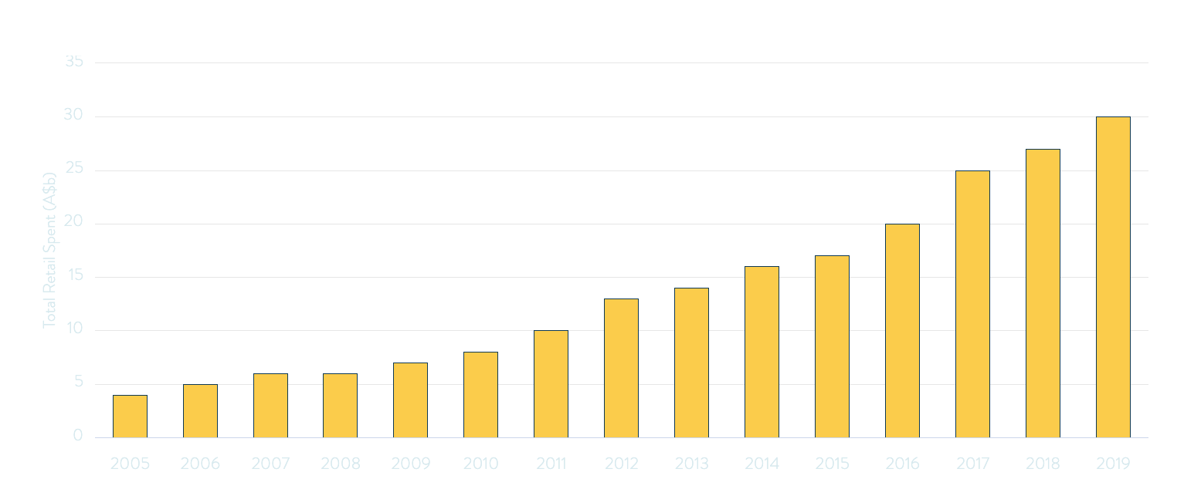

Exploratory Data Analysis
A history of ecommerce growth in Australia, pre COVID-1
Source: KPMG

Slide 4


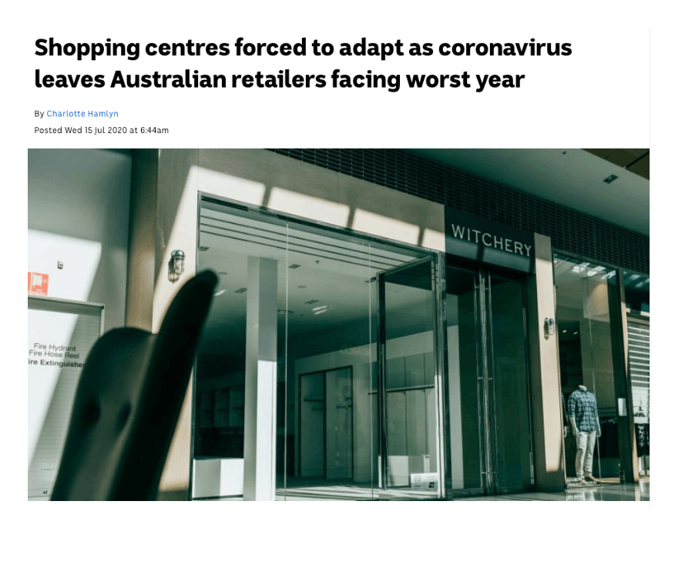
Retail plunge COVID July 2020 📉
Source: ABC Central Coast
Notes:
Make sure to point out your prospect's challenges, using a source that is not yourself.

Slide 5

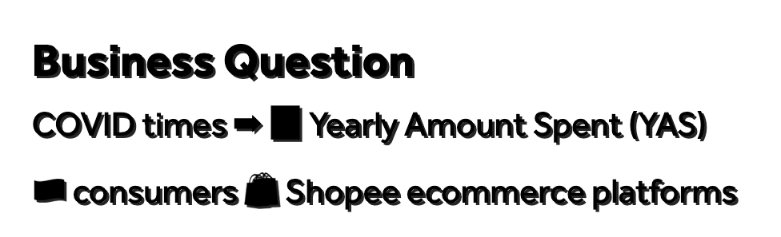

Business Question
COVID times ➡📈 Yearly Amount Spent (YAS)
🇦🇺 consumers 🛍 Shopee ecommerce platforms
Data Question
What are the characteristics of consumer behaviour on e-commerce platforms affecting YAS?
Stakeholders: Marketing department, Management Accountants, Senior Management, IT

Slide 6


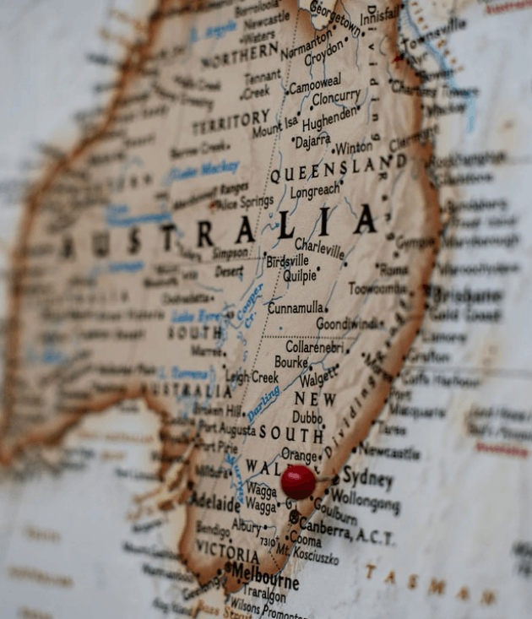


Exploratory Data Analysis
Database from 500 🇦🇺 customers purchase history from Shopee
Status quo: Shopee's model of success in SEA
Selected variables (features)
'Average session length',
'Time on app'
'Time on website'
'Length of membership'

Slide 7
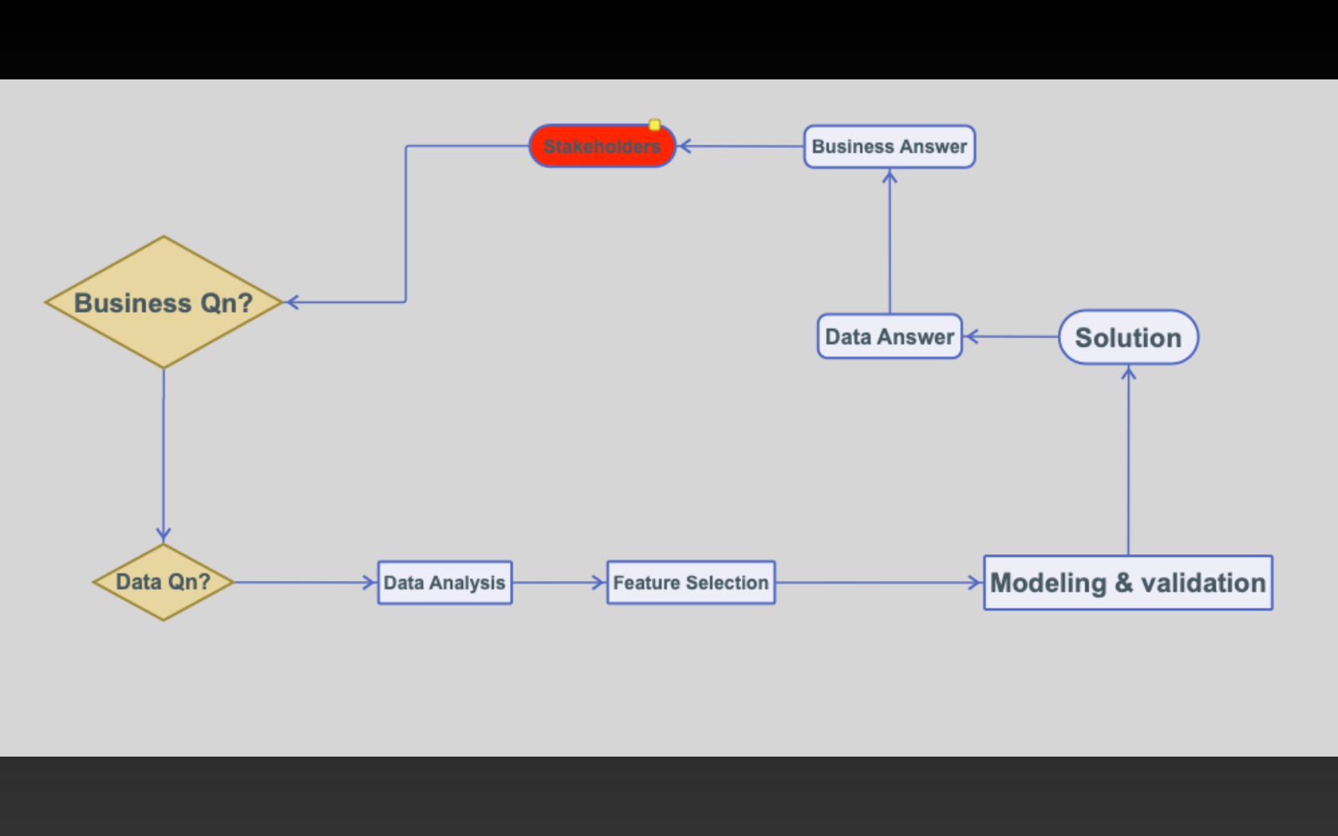

Project Pipeline

Slide 8

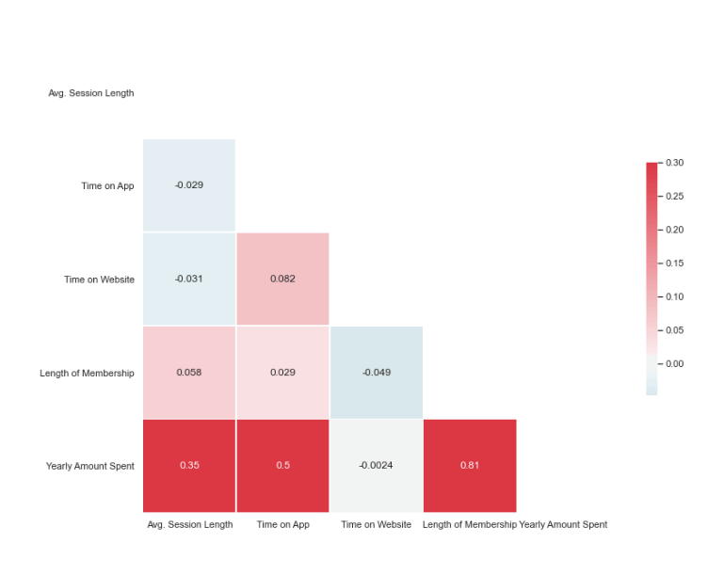

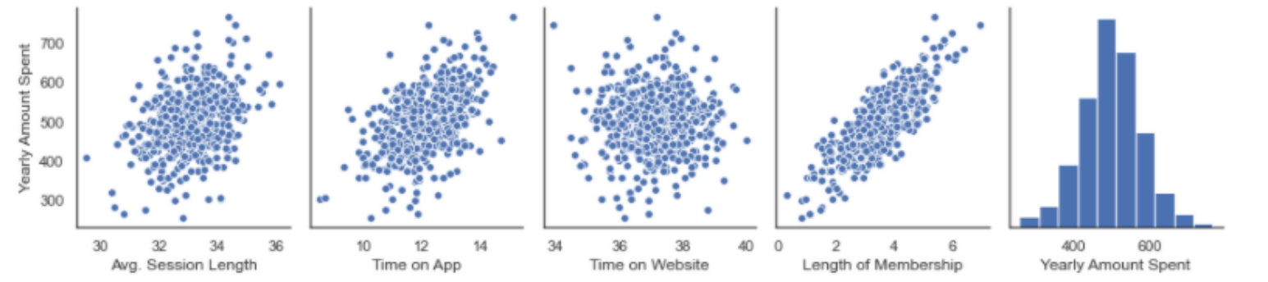
Features Selection
Machine learning - identify features of importance
Use selected features 🤖 predict YAS 💰

Slide 9


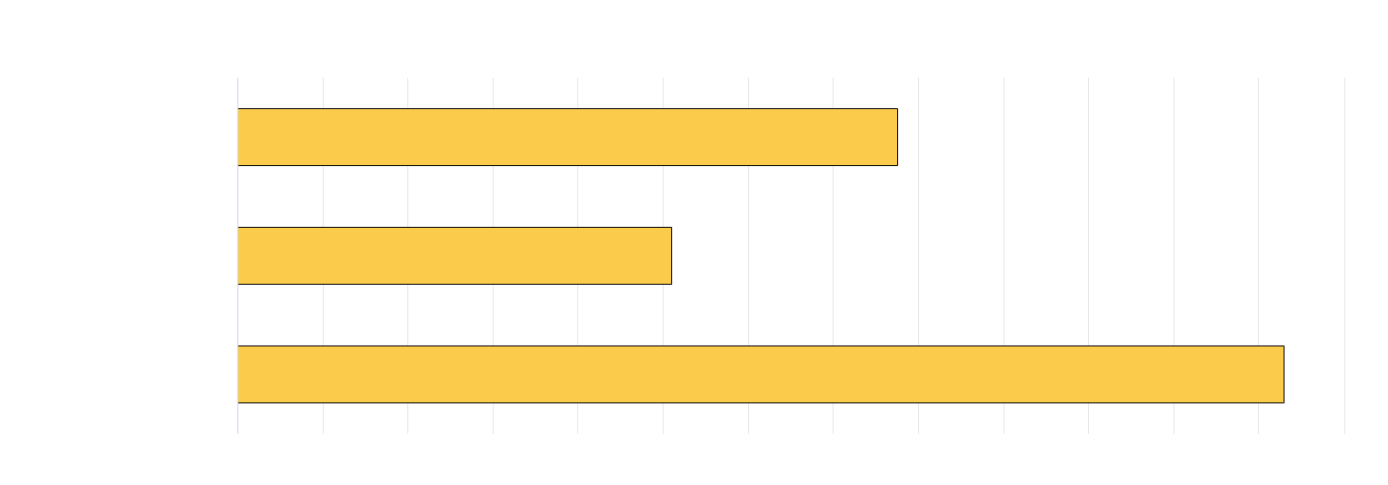
Yearly Amount Spent

Slide 10







Recommendations
Customer Clustering
Time Series
Image Processing
A/B testing
Recommender system eg Amazon, Netflix

Slide 11


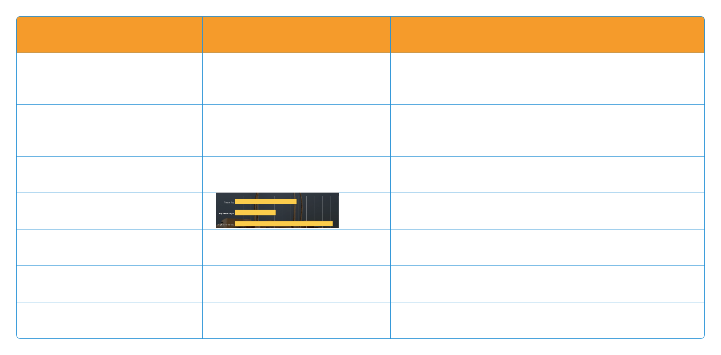
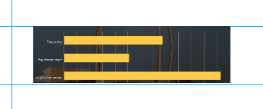
Summary
Data
Approach
Outcomes
500 customers from customer database
Select the most important features
Predictive modeling eg use of linear regression performed well to predict YAS
Target variable: Yearly Amount Spent (YAS)
Use most important features to predict YAS
4 features
Recommendations
'Avg session length'
'Time on website'
'Time on app'
'Membership length'

Slide 12


Thank u for listening!

